Slide 1
DITA Content Reuse

Slide 2
Session results
Content Reuse Benefits
DITA – Ways to Reuse Content
Content Reuse Candidates
Reusing DITA Maps
Reusing Topics
Reusing Pieces of Topics – Best Practices
CCMS Organization – How to accommodate reusable content
Selecting Content to Reuse

Slide 3
Content reuse benefits
Improves the efficiency of writers, editors, reviewers, translators, and customers/users
Improves the consistency and accuracy of content
Reduces risks associated with late-breaking changes by making content easier to update
Bottom Line: Consistency across deliverables = happier customers/users

Slide 4
DITA – Ways to reuse content
Content reuse requires an implementation strategy based on DITA best practices and the features of your CCMS
Reuse Options
Reusing DITA maps
Reusing topics
Reusing pieces of content (elements, sentences, and paragraphs) by using content references (conrefs)

Slide 5
Content Reuse Candidates - Group brainstorm
What types of content are great reuse candidates?
Copyright information
Logon information
Hardware requirements
Client requirements
Feature descriptions
Definitions/field descriptions
Support information
Product descriptions
Intended audience
Repeated notes, cautions
Paths or URLs
Product names

Slide 6
Reusing DITA maps
DITA maps are prime candidates for reuse
Combine map files for different personas, software modules purchased, and custom features

Slide 7
Reusing topics
Two ways to reuse topics
Reusing topics within the same DITA Map
Note: If you add the same topic two or more times to the same DITA map, you need to understand the Help output behavior.
Help output the topic appears more than once, but the links that are created to the Parent topics are different.
PDF output the topic appears more than once. Links from the TOC go directly to the right TOC topic.
Reusing topics within different DITA Maps

Slide 8
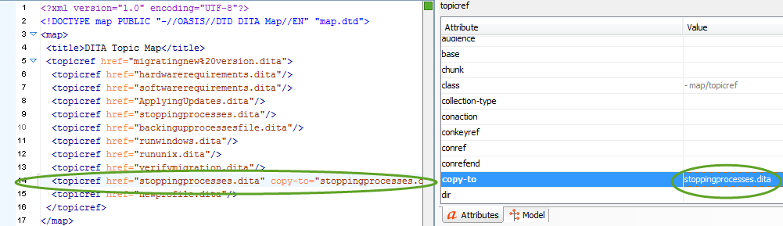
Reusing topics in the same DITA map
Add the topic to the DITA Map the first time
Add the topic to the DITA map a subsequent time and then add the copy-to attribute
If you add the same topic a third time to the map, add another different copy-to attribute

Slide 9
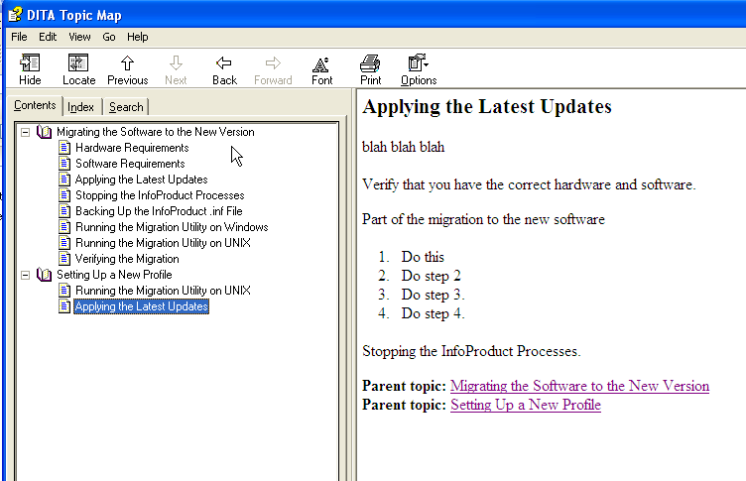
Help without using copy-to attribute

Slide 10
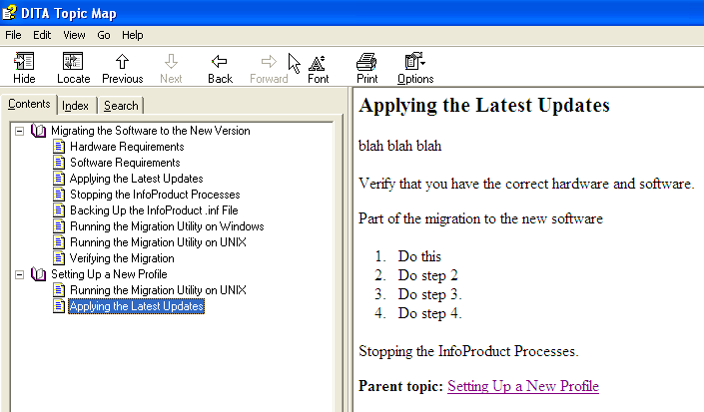
Help with copy-to attribute

Slide 11
Reusing Pieces of Content (Conref) – Best Practices
Element Level - Manage frequently updated content at the element level, proper nouns are a great choice
<cite> element for titles of books and information sets
<filepath> element for file, directory or path names
<keyword> element for product names or model numbers
<menucascade> and <uicontrol> elements for interface buttons, menus, check boxes, tabs, and other interface items
<wintitle> element for names of windows, panels, pages, or dialog boxes
Sentence Level - Use sentence-level reuse for stand-alone sentences, such as a note. Otherwise, use sparingly to avoid translation issues.
Paragraph Level - Paragraph-level reuse is most common; however, conrefs are syntax-aware. This means you can reuse the content only in context and for some content only in similar topic types.

Slide 12
Reusing pieces of content (conref) – best practices
Avoid spaghetti topics that have conrefs between one another because you create a maintenance nightmare
What do you do?
Designate topics for reuse
Designate a specific area in the CMS for these topics
Designate a folder structure in the CMS for these topics
Designated topics (stored in an area of the CMS) to put reusable elements in them
Product names
File paths
Notes
Glossary/field names
Designated folders that hold reused topics in the CCMS
Concepts, Tasks, References by product line perhaps
Notes:
The bonus of a CCMS is that you can reorg it without breaking links.

Slide 13
CCMS organization - perhaps looks like this
Common Concept Topics
copyright.xml
support.xml
basics.xml
Common Paragraphs
Product1_productoverview.xml
Product2_overview.xml
Common Elements
product_names.xml
publishing_names.xml
Product 1
Common Concept Topics
Concepts
Maps
Tasks
Reference

Slide 14
Let’s Practice – Reusing Content
Take a short user guide
Look at a PDF of the guide
Decide on content that to put in your “Common” area of the CCMS
Think about topic vs. paragraph reuse

Slide 15
Session Results – Where we’ve been
Content Reuse Benefits
DITA – Ways to Reuse Content
Content Reuse Candidates
Reusing DITA Maps
Reusing Topics
Reusing Pieces of Topics – Best Practices
CMS Organization – How to accommodate reusable content
Selecting Content to Reuse

Slide 16
Start thinking
When working on projects:
Think about content reuse
Start planning your content reuse on documents

